Slide 1
министерство науки и высшего образования Российской Федерации
федеральное государственное автономное образовательное учреждение высшего образования
«Национальный исследовательский университет ИТМО»
Факультет инфокоммуникационных технологий
Анализ поведения системы с использованием контекстных диаграмм DFD
Студент группы К3240 Вали Насибулла
Преподаватель Говорова Мария Михайловна

Slide 2

Name:
ADPRINT DEGITAL
Services:
Designing and Printing all desire Advertisement ads for any Business.
Management:
Director:
Responsible for working with the client and suppliers.
Controls layout designer and master
Layout designer - creates a layout.
Master - makes the product according to the layout and, if necessary, mounts it

Slide 3
Purpose and objectives Purpose:
master the practical skills and abilities of researching the subject area at the level of analyzing the behavior of the system using DFD diagrams (DFD).
Tasks:
Determine the purpose of the ИС.
Select the main process and external entities in relation to it.
Allocate threads for external entities in relation to the main event (functions / process / work).
Create a zero-level context diagram.
Analyze events (functions/works/processes), determine data flow relationships between entities, events, data storage devices.
Create a detailed context diagram.

Slide 4

Methods and means of project implementation:
Functional Modeling Method (DFD/Data Flow Diagrams)
Programs:
1. CA ERwin Process Modeler 7.3 for creating diagrams.
2. Powerpoint
3. Flowchart data Modeler draw.io

Slide 5
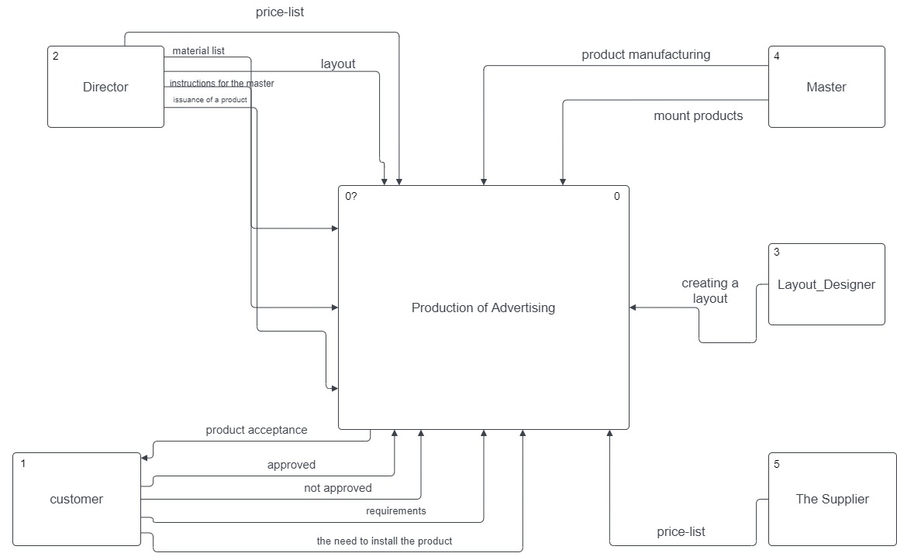
External entities, main process and links between them
Main process - production of outdoor advertising.
Essences:
1. Director
2. Customer
3. Master
4. Layout designer
5. Supplier

Slide 6
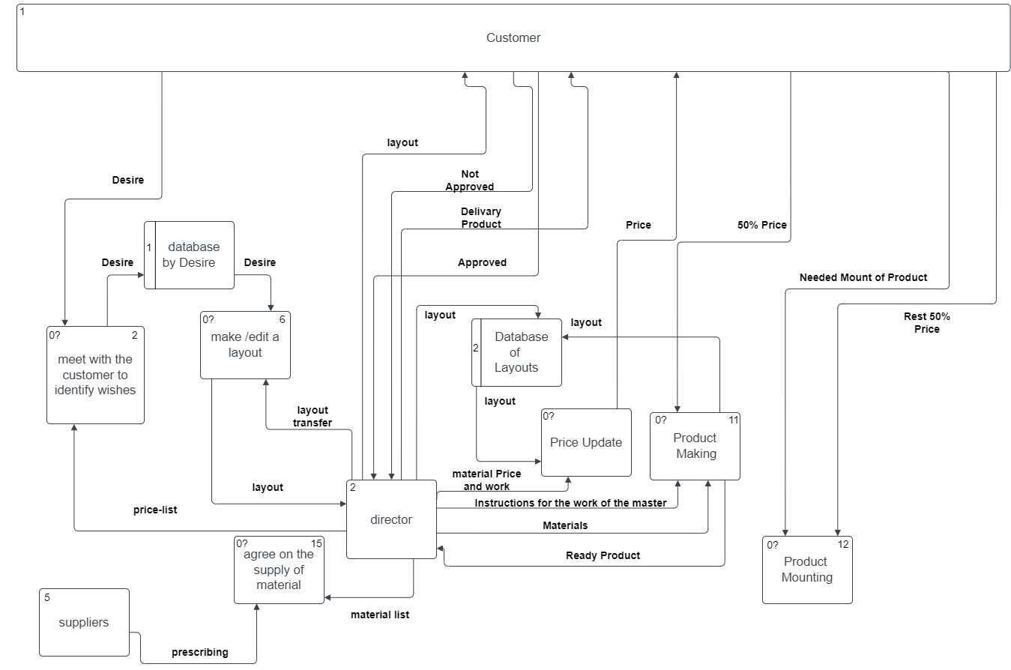
Detailed context diagram

Slide 7
Mastered the skills of researching a subject area at the level of analysis system behavior using DFD diagrams.
Also learned:
1. Break down the business description into entities and processes.
2. Find and analyze connections between them.
3. Think at different levels of abstraction (zero level and more detailed).
Realized how useful a structured approach to what is happening in the business and how DFD diagrams can help with this.
Conclusions

Slide 8
List of sources
1. Lectures DB 2021-2022
(https://drive.google.com/drive/folders/13iJoztFFU-T4NmuC3uhVMVS8DqjX-I0g)

Slide 9

The End.
Thanks for Attention.

